Slide 1
Phase 2 Project
NAME: BENSON MUNGAI MURIU

Slide 2
PREDICTING HOUSE SALES IN KING COUNTY
USING REGRESSION MODEL
Business Problem
The King county real estate agency helps homeowners buy and/or sell homes. A stakeholder would like to know how to increase the value of their homes using particular features.
Business question
The business question is how renovations might increase the value of their homes and by what amount?

Slide 3
OBJECTIVES
Import the required libraries
Load the given data
Inspect the data
Perform data cleaning
Begin regression modelling
Ask relevant questions that need to be answered in the form of visualizations.
Derive conclusions and recommendations.

Slide 4
DATA UNDERSTANDING
The project uses King County house sales to show data of home owners who have listed their homes for sales. The dataset includes data for 21,597 homes with 20 different features, which include:
`date` -Date house was sold
`price `- Sale price (prediction target
`bedrooms` - Number of bedrooms
`bathrooms` - Number of bathrooms
`sqft_living` - Square footage of living space in the home
`sqft_lot` - Square footage of the lot
`floors` - Number of floors (levels) in house
`waterfront` - Whether the house is on a waterfront
`view` - Number of times house has been viewed
`condition` - How good the overall condition of the house is. Related to maintenance of house
`grade` - Overall grade of the house. Related to the construction and design of the house
`sqft_above` - Square footage of house apart from basement
`sqft_basement` - Square footage of the basement
`yr_built` - Year when house was built
`yr_renovated` - Year when house was renovated
`zipcode` - ZIP Code used by the United States Postal Service

Slide 5
DATA PREPARATION
Handling the missing values.
Replace null values in the affected columns or rows.
The replace technique used was filling the null values using the median.
Why median?
The choice was informed by the fact that the mean could be affected by outliers and thus could offset our values or rather may end up giving a false impression.
There were no duplicates in the columns.

Slide 6
Exploratory Data Analysis
The data set was explored and various statistical measures were done to get the data
Univariate analysis where we explored single columns to see the statistical distribution i.e(mean, median, quartiles and standard errors.)
The Average house is sold at 540,000$
Houses are relatively sold equally each month of the year as observed in the 1 year time period from May 2014 to May 2015.

Slide 7
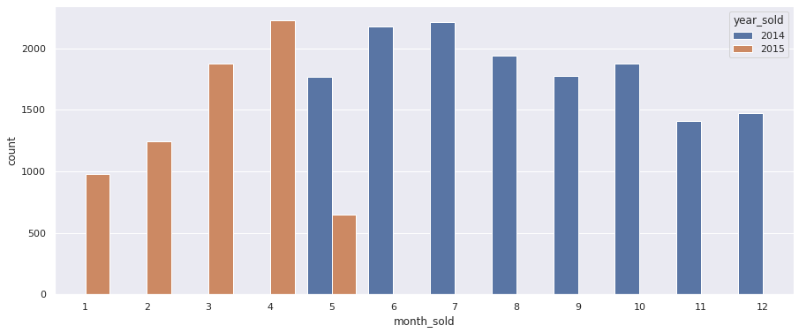
Month sales of houses from May 2014 to May
2015.

Slide 8
Questions to answer while analysing
Are there any outliers in the dataset?
What is the distribution of categorical variables(view,floors,grade,condition) in the data set?
What is the distribution of continuous variables(price,sqft_living,sqft_lot,sqft_above,sqft_basement) in the data set?

Slide 9
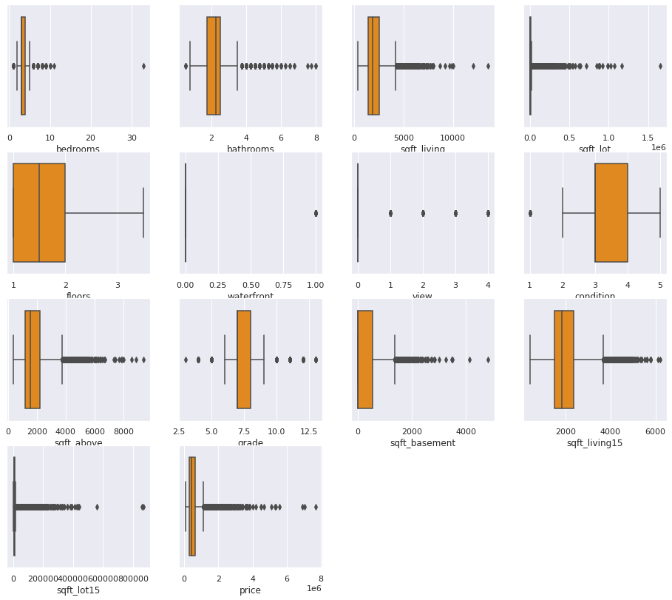
Q1.A boxplot showing outliers in the data

Slide 10
The boxplots show that there are outliers in bathrooms, bedrooms, sqft_living, sqft_living 15,sqft_lot and sqft_lot15
The outliers affect the data in that they are unique data having different data from normal. An example is a house having 33 bedrooms with a small living area.
The outliers are dropped to help analyse the data more accurately

Slide 11
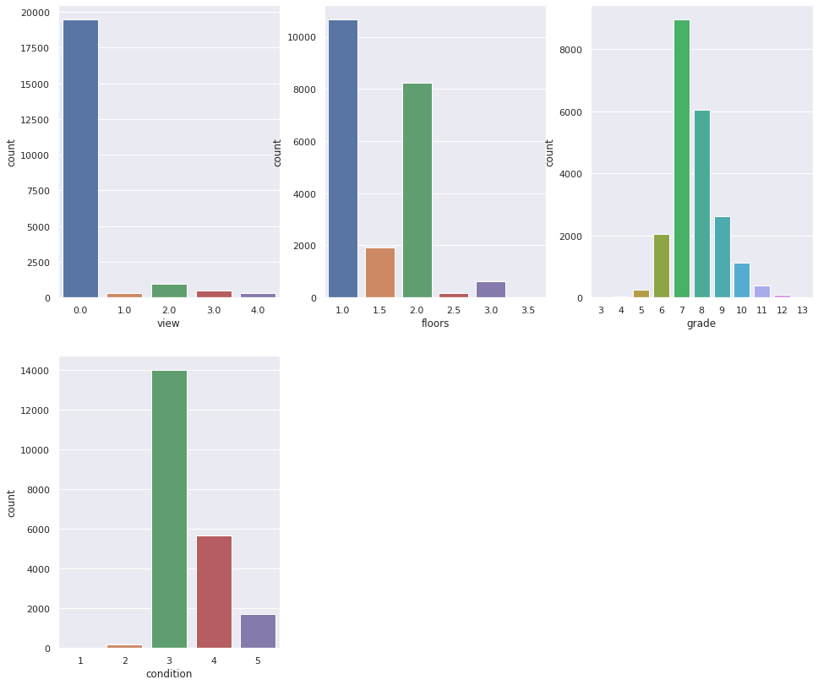
Q2.A distribution of categorical variables against number of houses

Slide 12
Condition: Relative to Age and Grade
1= Poor Many repairs needed. Showing serious deterioration.
2= Fair Some repairs needed immediately. Much deferred maintenance.
3= Average Depending upon age of improvement; normal amount of upkeep for the age
of the home.
4= Good Condition above the norm for the age of the home. Indicates extra attention
and care has been taken to maintain.
5= Very Good Excellent maintenance and updating on home. Not a total renovation.

Slide 13
Residential Building Grades
Grades 1 - 3 Falls short of minimum building standards. Normally cabin or inferior structure.
Grade 4 - Generally older low quality construction. Does not meet code.
Grade 5 - Lower construction costs and workmanship. Small, simple design.
Grade 6 - Lowest grade currently meeting building codes. Low quality materials, simple designs.
Grade 7 - Average grade of construction and design. Commonly seen in plats and older subdivisions.
Grade 8 - Just above average in construction and design. Usually better materials in both the exterior and interior finishes.
Grade 9 - Better architectural design, with extra exterior and interior design and quality.
Grade 10 - Homes of this quality generally have high quality features. Finish work is better, and more design quality is seen in the floor plans and larger square footage.
Grade 11 - Custom design and higher quality finish work, with added amenities of solid woods, bathroom fixtures and more luxurious options.
Grade 12 - Custom design and excellent builders. All materials are of the highest quality and all conveniences are present.
Grade 13 - Generally custom designed and built. Approaching the Mansion level. Large amount of highest quality cabinet work, wood trim and marble; large entries

Slide 14
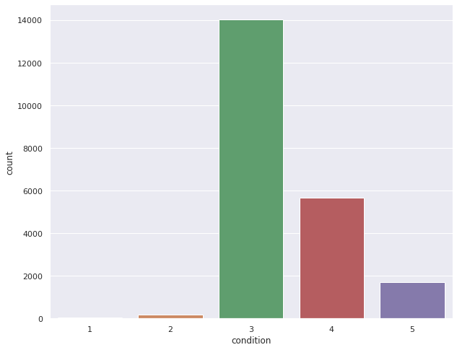
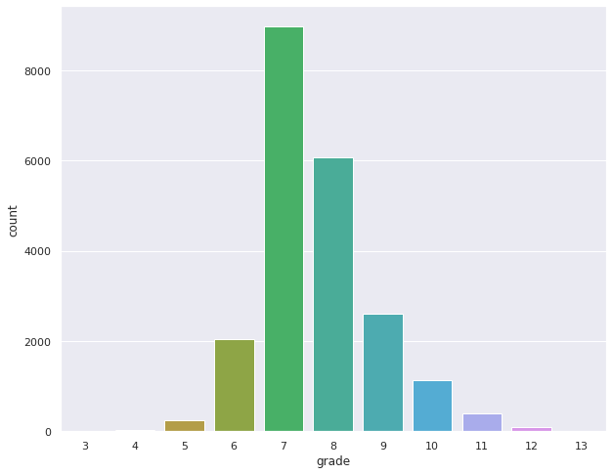
Grade and condition of houses

Slide 15
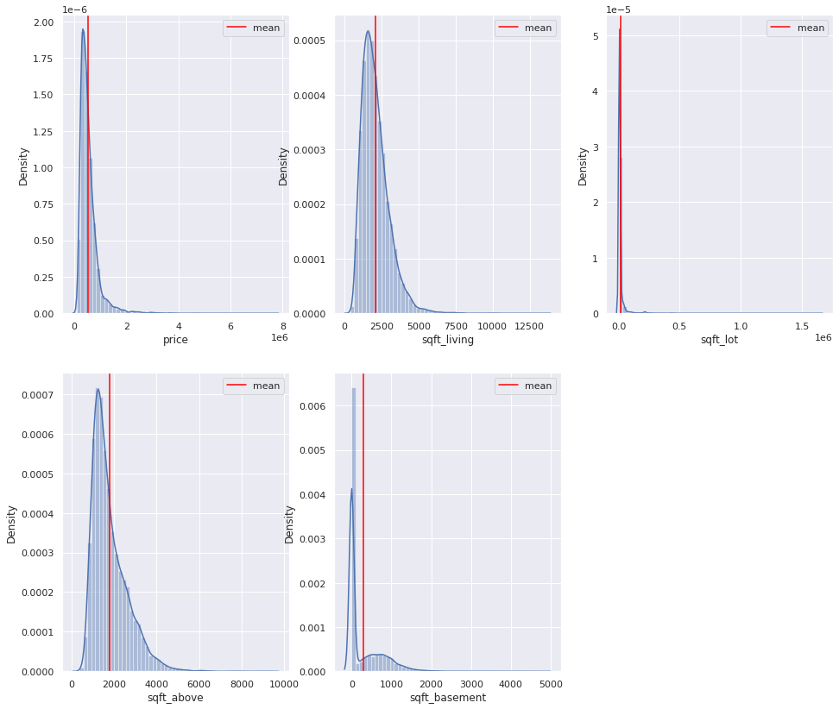
Q3. Distribution of continuous variables

Slide 16
Bivariate analysis
This is analysis between the target variable (price) and the other variables.
Graphs below show :
The correlation between price and the other variables
A bar graph between price and categorical variables
A scatter plot between price and continuous variables

Slide 17
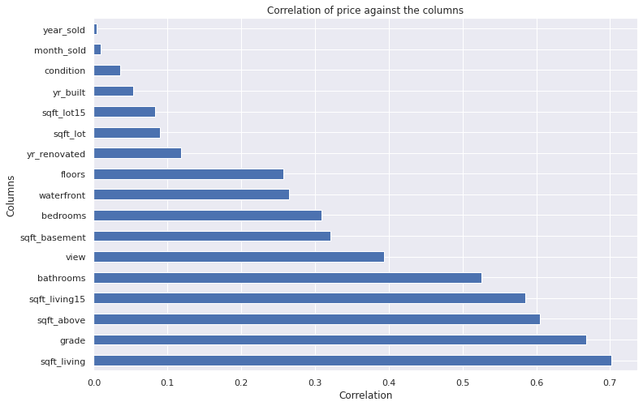
Correlation between price and other variables

Slide 18
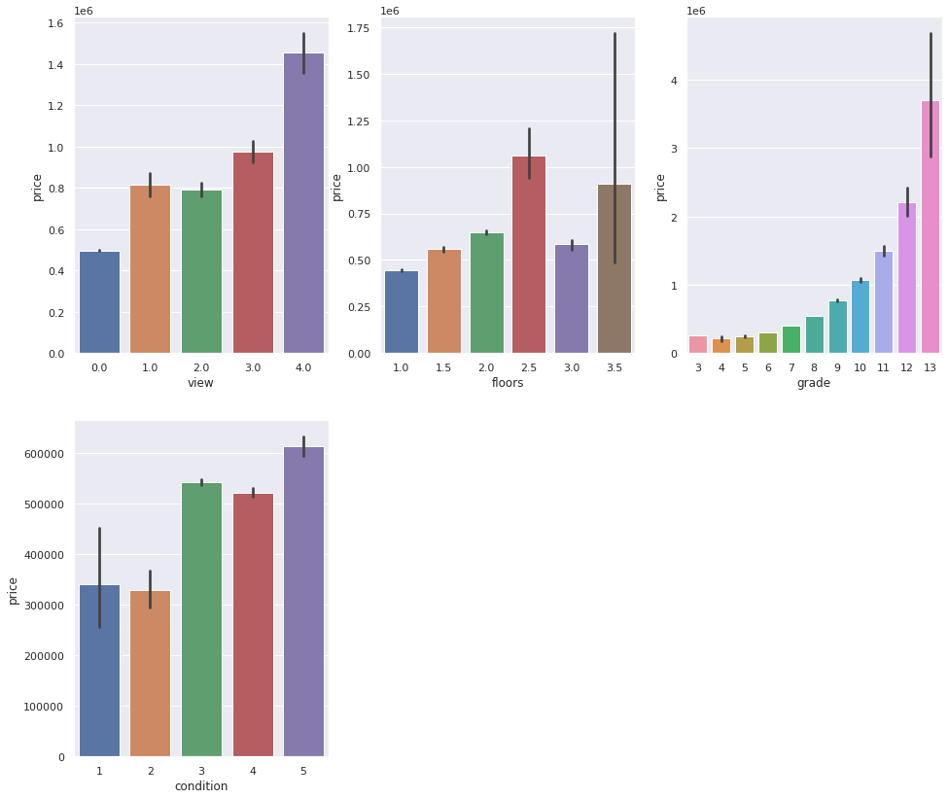
Bar graphs of price against variables

Slide 19
Modelling
The variables are prepared to make the model in order to answer the business question.
The model then predict using the variables given
In one of the models, the variables are included together with our target of renovations
In another the model, it lacks the variable and then the model predicts
The difference shows how much renovations affect the price of a house and by how much.

Slide 20
Conclusions
The variables affect the price differently where categorical variables show a how different categories perform price wise and continuous variables show how an increase in a variable affects the price of the house.
The square footage of the house of the home is what affect the price the most compared variables, followed by grade.
Most houses are at average condition and average grade therefore this is a good standard
Above half of the houses have never been renovated before.
In the models, it is noted that house increase prices with variables that have above average rating in most variables.
From observation, considering less houses have not been renovated, it shows an increase in the value of the house by an average of 274$
In conclusion, houses increase value when renovation takes place to reach an average condition and grade of a normal house by 274$. More renovations made will increase the house prices by a larger value.

